Slide 1
Where to buy as a first-time buyer in London

Slide 2
Where to buy as a first time buyer in London ?
London Housing Market is one of the most expensive of the world
Only a small portion of first-time buyers (FTBs) is able to afford a house and get on the property ladder :
The average house price in London purchased by first time buyers is 400 K.
The average age to purchase a house for the first time in London is 33 years old
First-Time buyers are mostly couples buying together (77%)
37% of FTBs have children
London is administratively divided into 32 boroughs, with significant disparity between them in terms of average house price and venues
Where (i.e. which boroughs) should first-time buyers purchase a house in London based on affordability (i.e. average house price) and infrastructure (i.e. venues) criteria ?

Slide 3
Data acquisition and Cleaning
Data used to solve the problem comes from various sources
Average house price information is sourced from government and land registry statistics using their standard reporting tool https://landregistry.data.gov.uk/app/standard-reports
Borough coordinates data scraped from Wikipedia https://en.wikipedia.org/wiki/List_of_London_boroughs
First time buyers profile information can be found here
Used panda read method to convert average house price per borough data and borough coordinates data into panda data frames
Cleaned the data by dropping irrelevant rows and columns
Merged the two data frames to obtain a single data frame with coordinates and average house price per borough

Slide 4
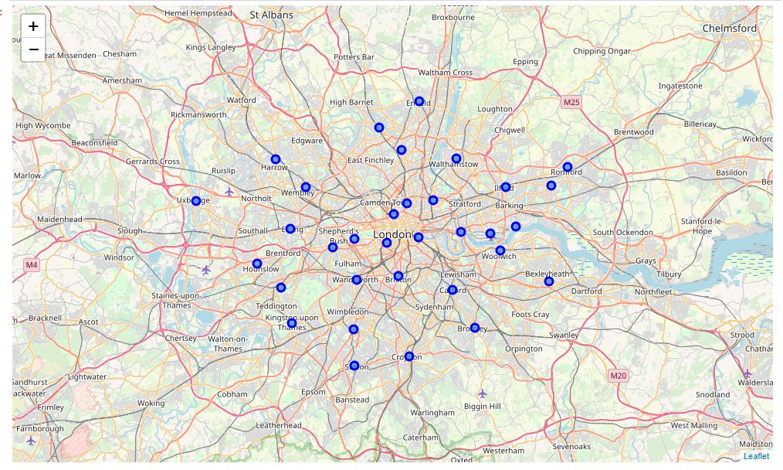
Visualizing and exploring London Boroughs
Used python folium library to create a map of London with borough superimposed on top.
And then used four square API to explore each borough and get the 100 top venues for each borough

Slide 5
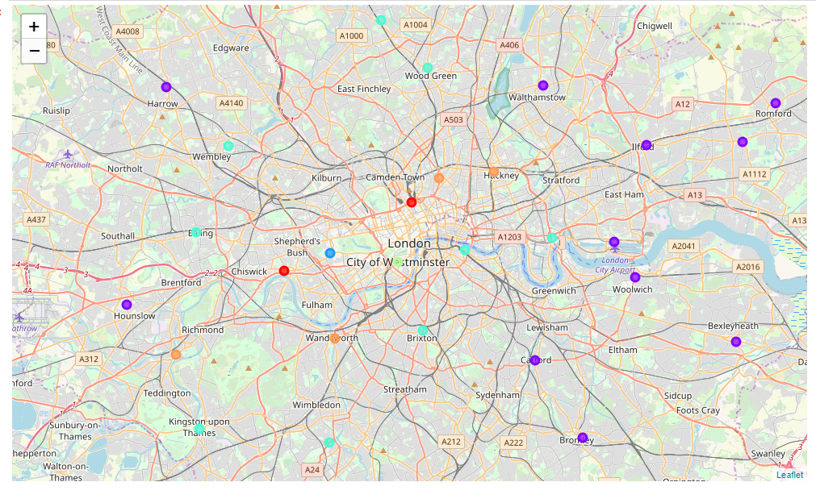
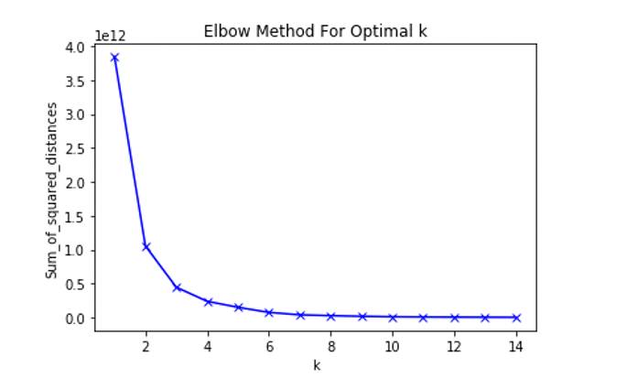
Clustering the boroughs
Used K-means to cluster the boroughs based on average house price and venue categories
Before running k- means on the data, used elbow method to determine optimal k
Optimal K is 7
Optimal k is 7

Slide 6
Analysing the results from a price perspective*
Boroughs in clusters 2,4 and 5 have average house prices 2 to 5 times higher than the average purchase price for FTBs (400K) and are very likely to be out of touch for FTBs
Borough in clusters 6 (between approx. 500 - 600K), 3 (between approx. 600K-700k) and 7 (between 700K and 800K) are gradually higher than the average purchase price purchased by FTBs and potentially affordable for a small portion of FTBs with better incomes
Boroughs in cluster 1 is are in line with the average house price purchased by FTBs (400K) and perfectly fit affordability criteria for FTBs
From a price perspective, only boroughs in clusters are 1,3,6, 7 are likely to be affordable for FTBs and should be focused on when looking to purchase a first house
* See Cluster Data in Appendix

Slide 7
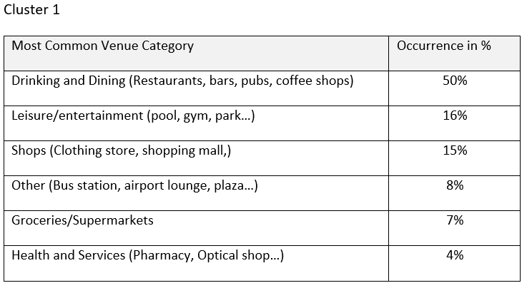
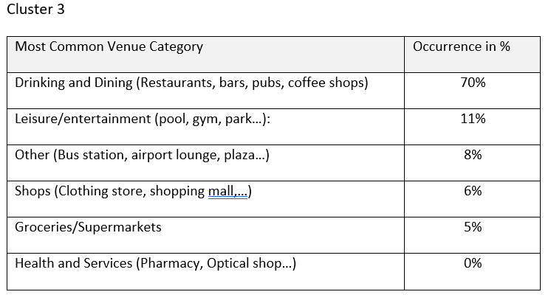
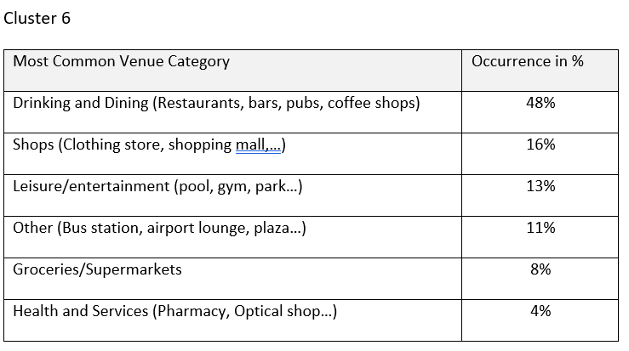
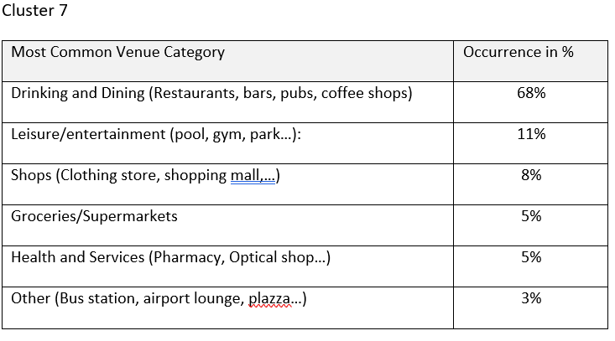
Analysing the results from a venue perspective*
If we regroup the most common venues per category, we obtain the following table for clusters 1,3,6,7
The most represented categories in all cluster is drinking and dining, categories are more evenly distributed in cluster 1 and 6, while in cluster 3 and 7, dining and drinking is overly represented
More variety and balance in clusters 1 and 6 with more local amenities, health and services, leisure and shops and a great variety of drinking and dining options
Based on FTBs profile data (most likely to be in their thirties, buying as a couple, and potentially with a child) Boroughs clusters 1 and 6 are more likely to suit FTBs profile
Boroughs in clusters 3 and 7 with over representation of drinking and dining venues are more likely to suit a student/single/renting lifestyle.
* See cluster data in appendix

Slide 8
Conclusion
Based on affordability and venue criteria as well as FTBs profiles, the best boroughs to invest in as FTB are:
Boroughs in cluster 1
Potentially boroughs in cluster 6 for FTBs with higher income
Boroughs in cluster 3 and 7 are less likely to suit FTBs given their higher average price and venue categories more suited for a student/single/renting lifestyle
Boroughs in cluster 2,4,5 are very likely to out of touch for FTBs as too expensive.

Slide 9
Appendix

Slide 10
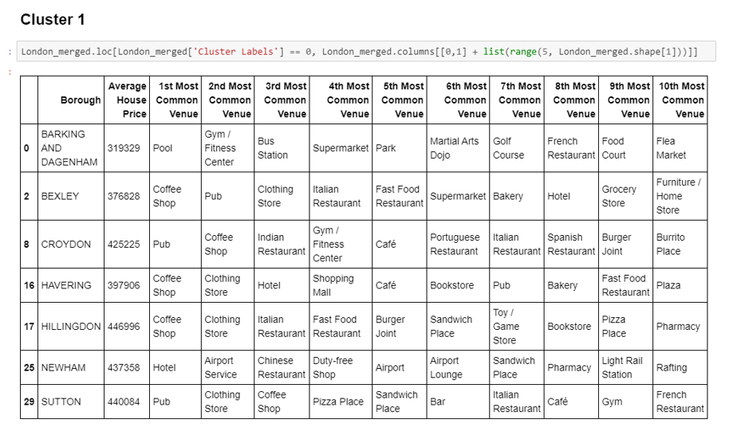
Cluster 1

Slide 11
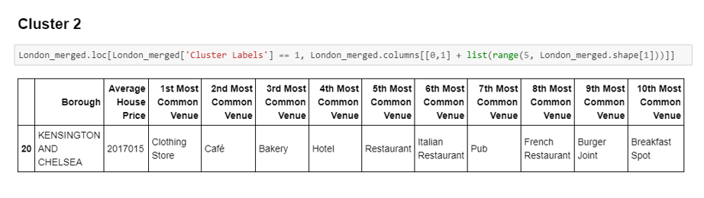
Cluster 2

Slide 12
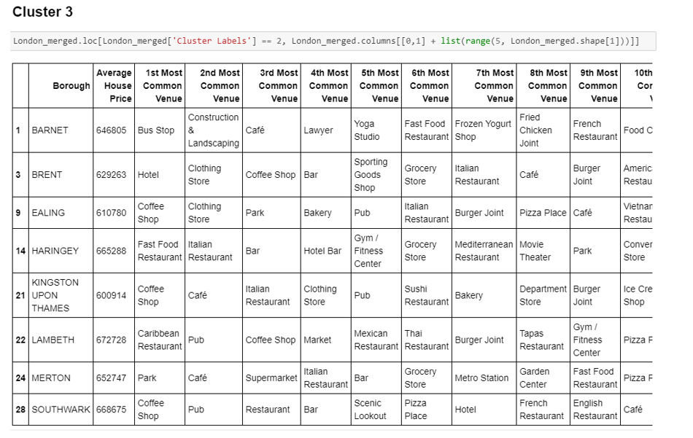
Cluster 3

Slide 13
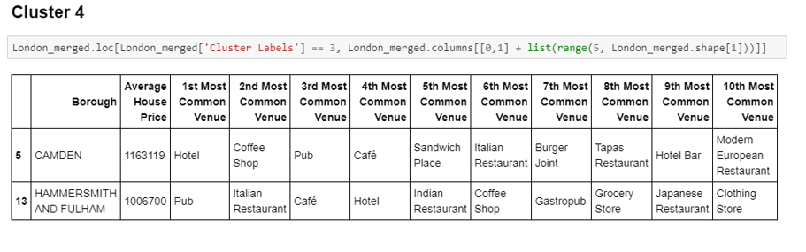
Cluster 4

Slide 14
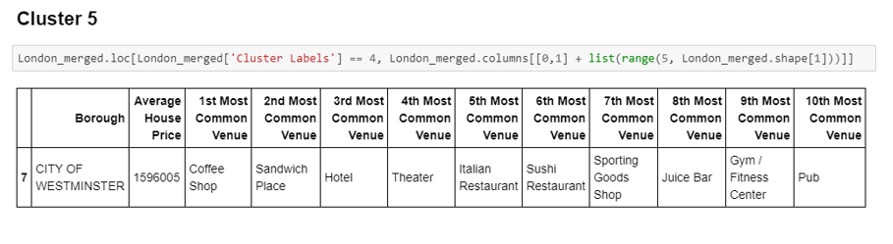
Cluster 5

Slide 15
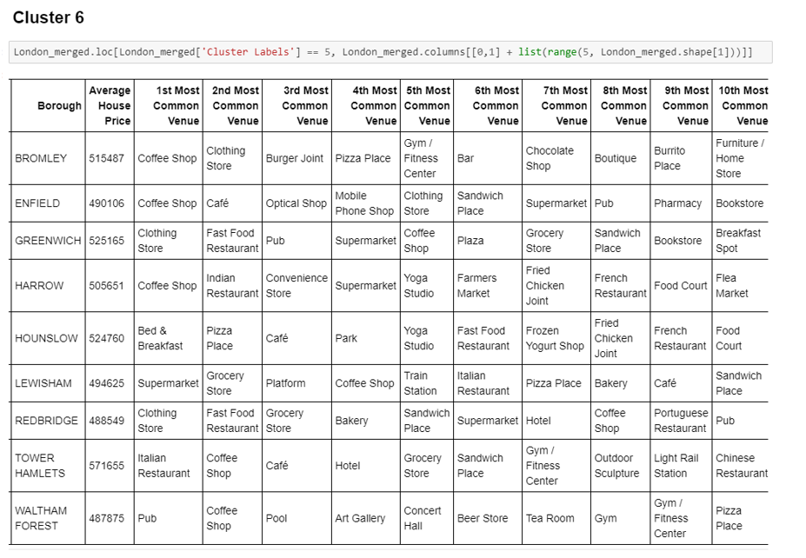
Cluster 6

Slide 16
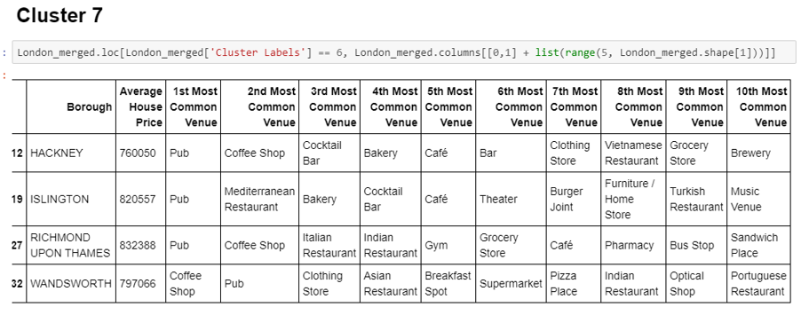
Cluster 7

